Slide 1
AVR Architecture 1 – ATMEGA 328
Dr.Sreejith Rajan

Slide 2
Introduction
What is AVR?
Architecture by Alf-Egil Bogen and Vegard Wollan.
Family of 8-bit RISC microcontrollers
Developed by Atmel (now Microchip)
Widely used in Arduino boards, embedded systems, and consumer electronics

Slide 3
Why AVR
Simple, efficient, and beginner-friendly
Rich set of peripherals (timers, ADC, serial interfaces)
Strong foundation for learning microcontrollers and embedded systems

Slide 4
Key Features
RISC architecture → Most instructions execute in 1 clock cycle
Harvard architecture → Separate program & data memory

Slide 5
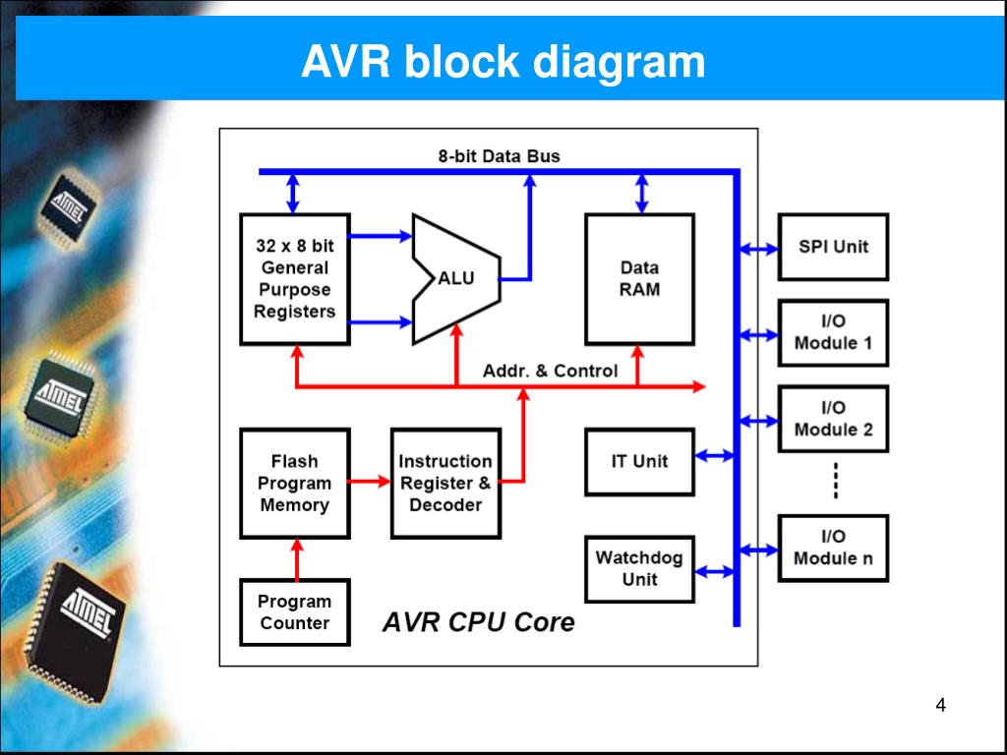
AVR Block Diagram

Slide 6
ATMEGA 328
8-bit AVR RISC CPU
32 × 8-bit General Purpose Registers directly connected to ALU
Flash Program Memory: 32 KB
SRAM: 2 KB
EEPROM: 1 KB (non-volatile data storage)
0
1

Slide 7
ATMEGA 328
Operating Frequency: up to 20 MHz (16 MHz on Arduino UNO)
Operating Voltage: 1.8 V – 5.5 V
I/O Pins: 23 programmable I/O lines
Timers: Two 8-bit timers (Timer0, Timer2)
One 16-bit timer (Timer1) with capture/compare/PWM
0
1

Slide 8
ATMEGA 328
Analogue-to-Digital Converter (ADC):10-bit resolution, 6 channels (DIP package), 8 channels (TQFP/QFN)
Communication Interfaces:
USART (serial)
SPI
I²C
0
1

Slide 9
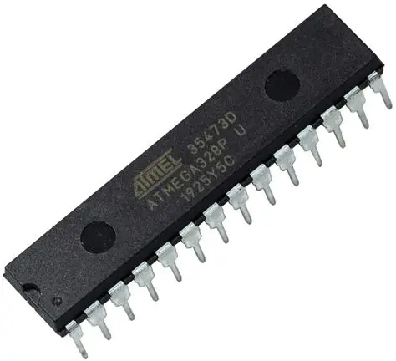
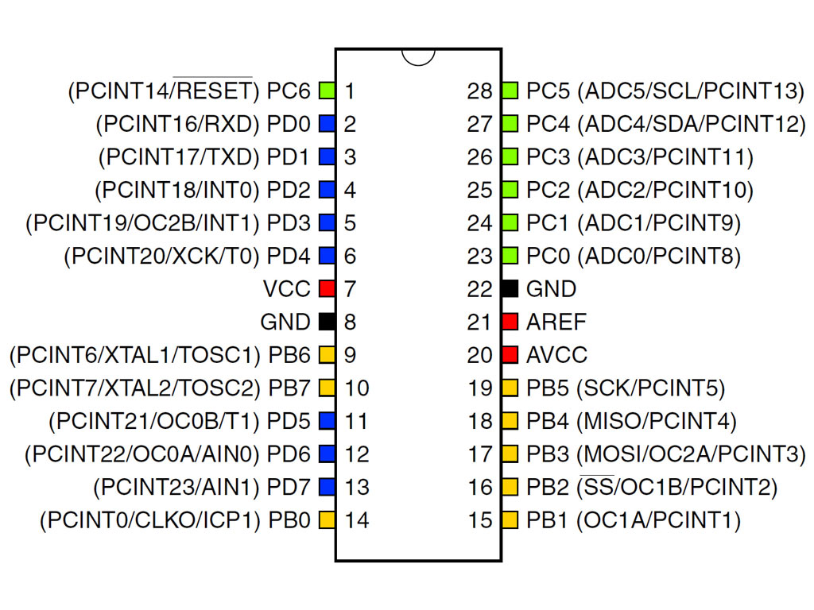
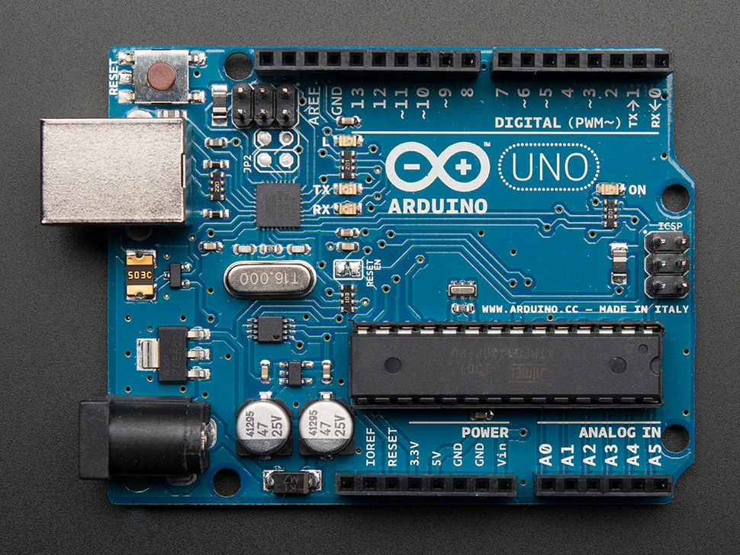
ATMEGA 328
0
1

Slide 10
ATMEGA 328 – GPIO Programming
4 Things to remember
Data Direction Register(DDRx) register
0 means that the pin is INPUT. 1means that the pin is OUTPUT
PORTx register (outputting value to a pin)
PINx Register (inputting value through a pin)
Bitwise operations
0

Slide 11
THANK YOU

